Slide 1

Data Programming Crypto currency Analysis & web development
Group members:
Ishmeet Kaur- 200591350
Megha Patel- 200590965
Tisha Arora- 200591979
Amanpreet Kaur-200564069

Slide 2
Table of Contents
Team
Research questions
Project Summary
Languages & Tools
Fit Gap Analysis
Database

Slide 3




Team
Project Manager Developer Business Analyst Data Analyst
Megha Patel Ishmeet Kaur Amanpreet Kaur Tisha Arora

Slide 4

Project Requirement
Topic - XYZ Corporation is looking for a way to show the features and trends of cryptocurrency marketplaces visually. Our team has what it takes to use Coinbase data to deliver this solution. We are the right team to successfully complete the data gathering, storage, and presentation activities described in the project requirements because we have the ideal combination of analytical and technological experience.
Objective - Build a web application that can show real-time bitcoin market data that has been retrieved from Coinbase. Make sure that a scheduled batch task updates the database with the most recent information every 24 hours.

Slide 5
Project Summary
Fetch
Fetch real-time crypto currency data.
Store
Store data in cloud MongoDB database.
Display
Display data on web application.
Build
Build an API for Data Access.
Conduct
Conduct Fit Gap Analysis.

Slide 6
Application Description
The MongoDB cluster that hosts this web application retrieves cryptocurrency data from the Coinbase API. The application offers routes and API endpoints for data collecting and retrieval, and the data is kept in a MongoDB database. The data is updated every 24 hours thanks to a scheduled batch operation. Visual Studio Code is used in the development of the program, along with additional HTML for the front end. Python libraries are used to visualize bitcoin trends, giving users access to an engaging dashboard that helps them study and comprehend the dynamics of the market.

Slide 7
Research Questions
What are the key trends in Bitcoin prices over time?
01
Which cryptocurrencies consistently rank among the most expensive?
02
What are the potential risks and opportunities for investors based on the price trends of these cryptocurrencies?
03

Slide 8

Languages & Tools
Python
Html
MongoDB
Coinbase
Github

Slide 9
Steps Involved
Step 1: Use Python to retrieve current cryptocurrency data from the Coinbase API.
Step 2: Store the fetched data in a MongoDB Atlas cloud database.
Step 3: Develop a Flask web application to display the data on the website.
Step 4: Implement a batch process in Python to update the database every 24 hours.
Step 5: Create an API in Flask to provide endpoints for accessing the data.
Step 6: Visualize the cryptocurrency data using Python libraries (e.g., Matplotlib)

Slide 10

Database
We have employed Atlas MongoDB.
This cloud database system offers scalability and dependability.
A NoSQL database called MongoDB uses documents that resemble JSON to store data.
It works very well with big datasets that contain intricate, unstructured data.
For database interaction, we utilized Pymongo, and for data management, we used MongoDB Atlas UI.

Slide 11
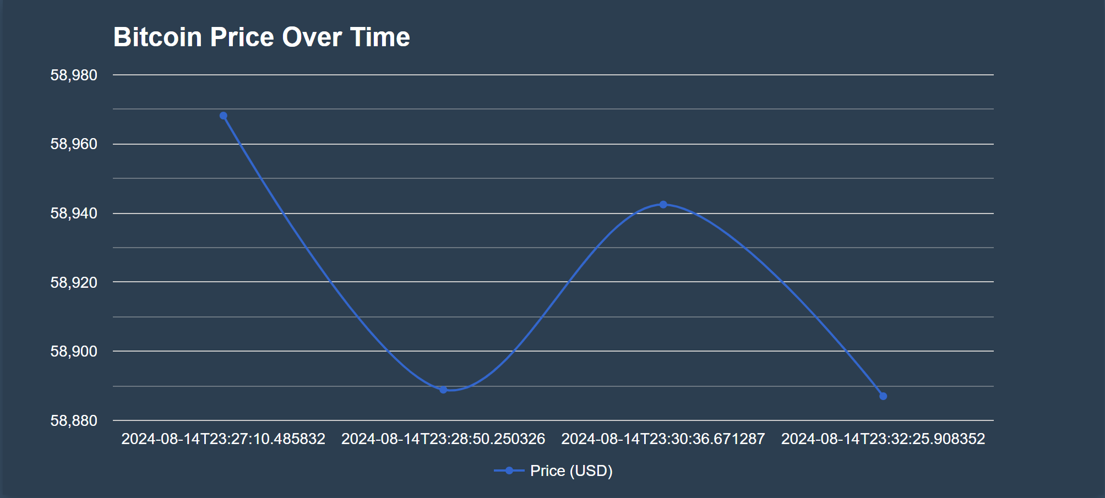
Visualization

Slide 12
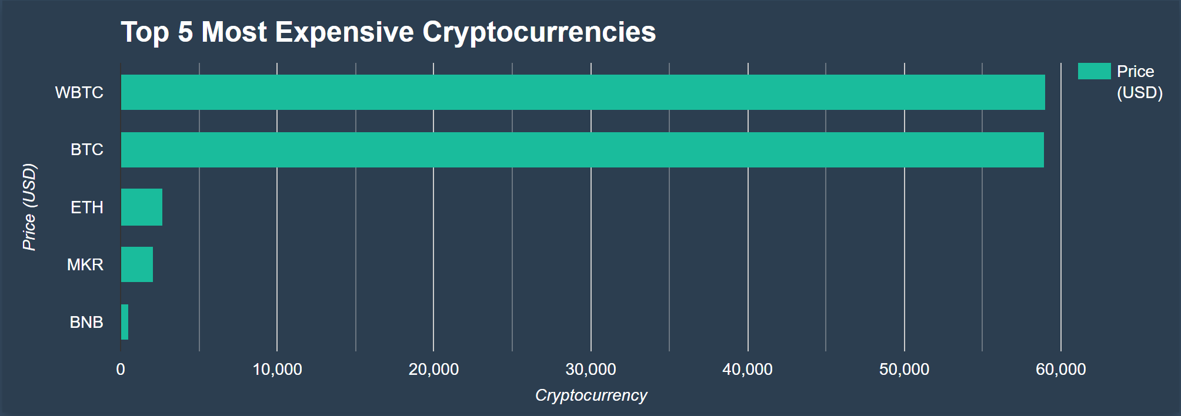

Slide 13
Fit-Gap Analysis
Data Acquisition:
Fit: Successfully implemented data fetching from the Coinbase API using Python. The application correctly retrieves and updates cryptocurrency data every 24 hours, aligning with the requirement.
Data Storage:
Fit: Data is stored in a MongoDB Atlas cluster, as specified. The database schema supports the storage of all necessary cryptocurrency data, providing efficient data retrieval and storage capabilities.
Web Application Development:
Fit: Developed a Flask web application that displays the cryptocurrency data on a user-friendly interface. Integrated charts and graphs to visualize trends and patterns, meeting the project’s visualization requirements.
API Development:
Fit: An API was created with endpoints for accessing cryptocurrency data. The API allows fetching of all items, filtering by criteria, and retrieval by ID, fulfilling the project’s API requirements.

Slide 14

Continued…
Visualization:
Fit: Implemented data visualization using Python libraries, such as Matplotlib or Plotly, and Google Charts. The visual representations provide clear and interactive insights into cryptocurrency trends, aligning with the project’s goals.
Deployment:
Fit: The web application was successfully deployed on a cloud platform (e.g., Heroku, AWS), making it accessible online. This meets the requirement of making the application accessible via a URL.

Slide 15
Continued…
Real-Time Updates:
Gap: While data updates every 24 hours, the application could be enhanced to offer real-time updates for more dynamic data monitoring.
Advanced Filtering and Analysis:
Gap: The current implementation might lack more advanced filtering options or analytical tools, which could be an area for future improvement.
Scalability and Performance Testing:
Gap: Further testing could be performed to ensure that the application scales effectively with increased data load and user traffic.

Slide 16
Thank you

